Slide 1


Diagrams Presentation on Gamified Learning Platform for Rural Education with AI Visual Conversion​
Guided By: Presented By:
Internal Guide: Prashant Jagtap(0827IT231101)
Prof. Deepak Singh Chouhan Sarthik Yadav (0827IT231120)
Shreyansh Sharma (0827IT231130)
External Guide: Somil Jain (0827IT231135) Mr. Naman Jagtap

Slide 2
Contents
Use Case Diagram
Class Diagram
Sequence Diagram
Data Flow Diagram
State Diagram

Slide 3
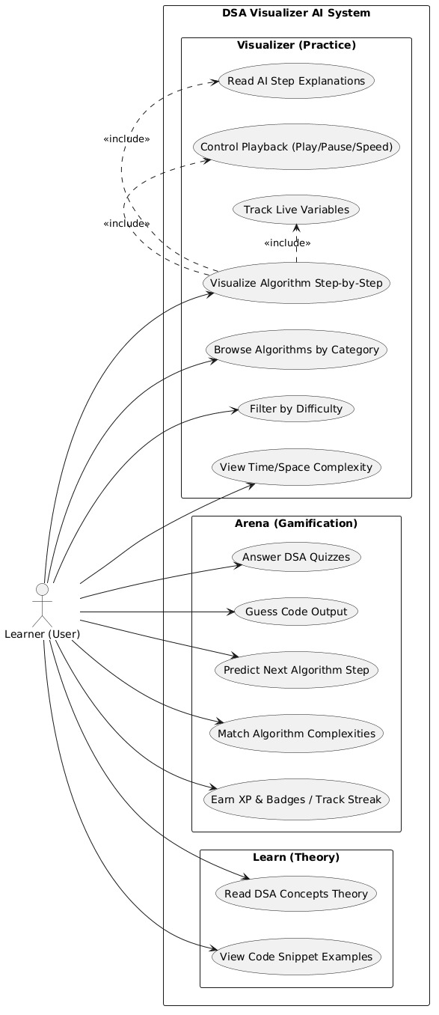
1. Use Case Diagram
System & Actor
System: DSA Visualizer
Actor: Learner
1. Visualizer (Practice)
Step-by-step visualization
Category browsing
Difficulty filtering
Complexity viewing
AI explanations (<<include>>)
Playback controls (<<include>>)
Variable tracking (<<include>>)
2. Arena (Gamification)
DSA quizzes
Output guessing
Step prediction
Complexity matching
Gamified rewards
3. Learn (Theory)
Theory reading
Code examples

Slide 4
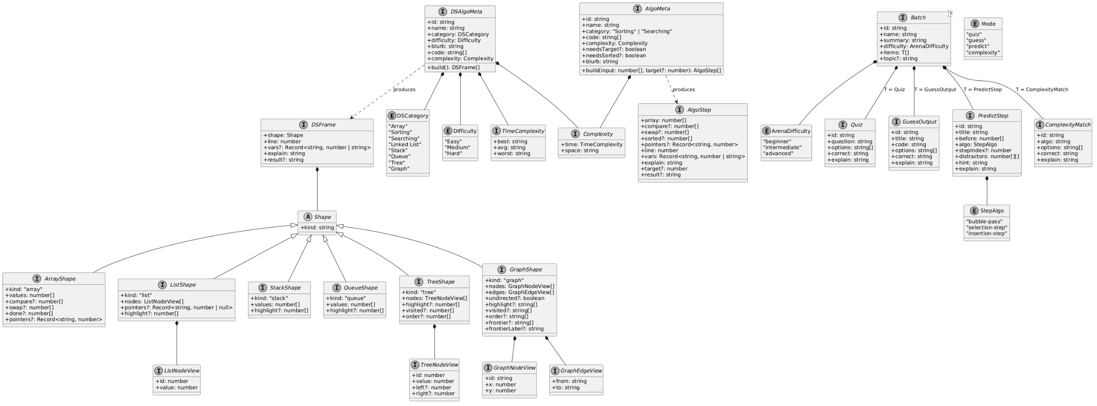
2. Class Diagram
Core Metadata Flow
DSAlgoMeta -> AlgoMeta
State Evaluation Flow
DSFrame -> AlgoStep
Visual Geometry Flow
Shape -> ArrayShape -> ListShape -> StackShape -> QueueShape -> TreeShape -> GraphShape
Layout Detail Flow
ListNodeView -> TreeNodeView -> GraphNodeView -> GraphEdgeView
Gamification Flow
Batch -> Quiz -> GuessOutput -> PredictStep -> ComplexityMatch

Slide 5
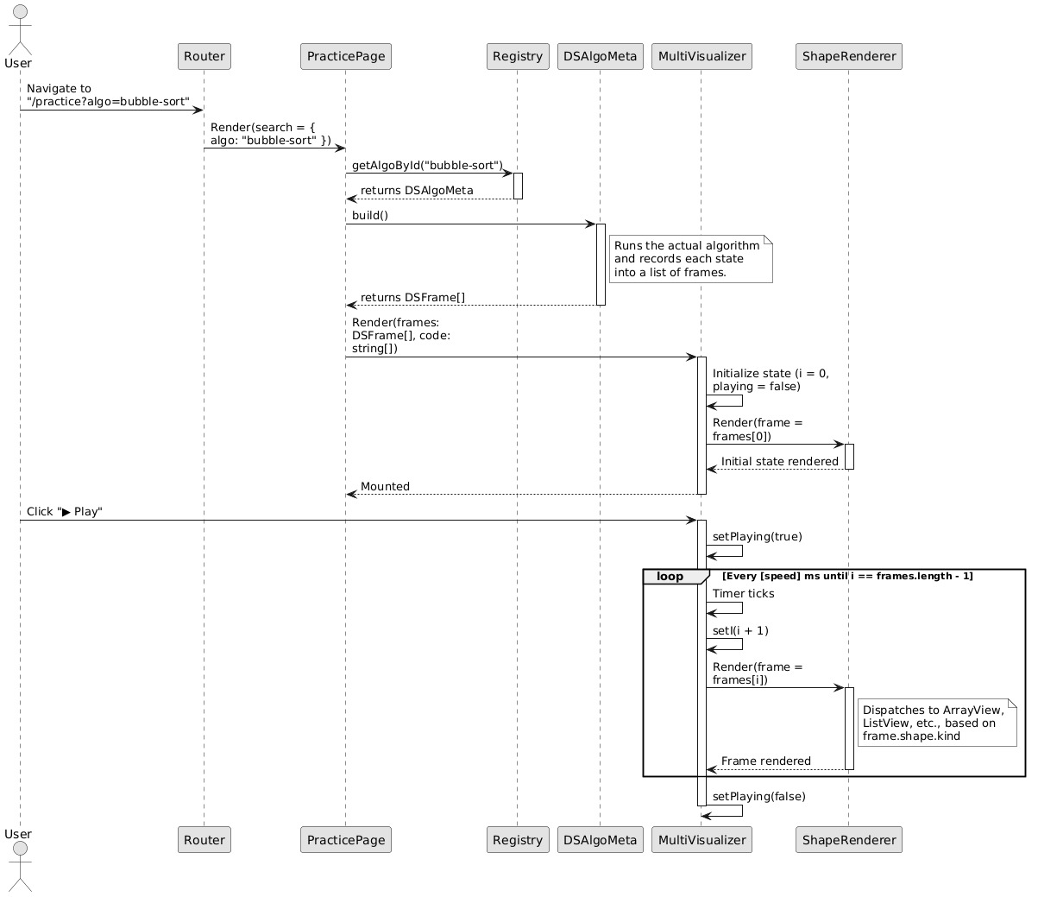
3. Sequence Diagram
Navigation Flow
User -> Router -> PracticePage
Initialization Flow
PracticePage -> Registry -> DSAlgoMeta -> MultiVisualizer -> ShapeRenderer
Execution Flow
User -> MultiVisualizer -> ShapeRenderer

Slide 6
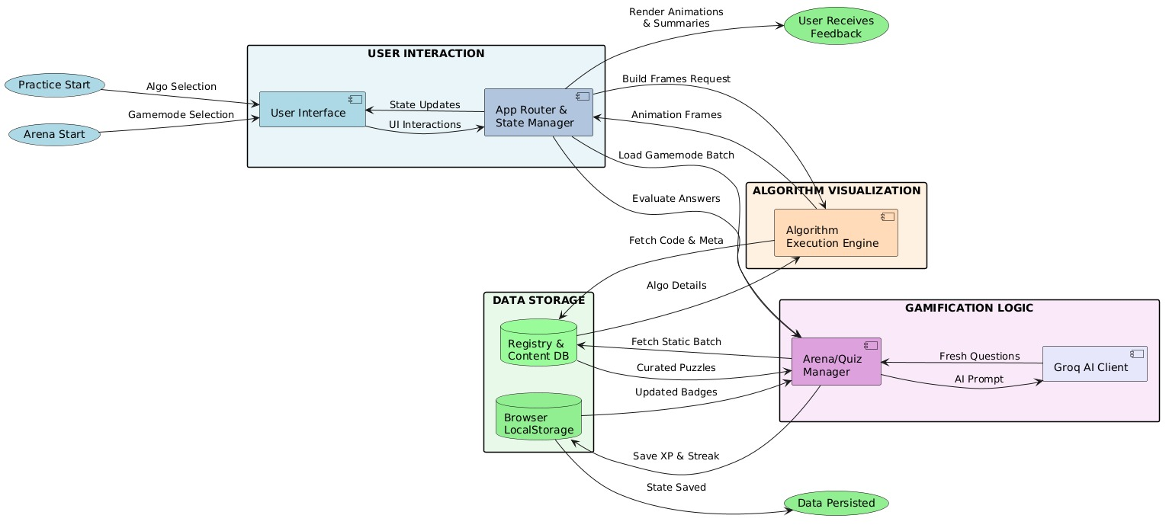
4. Data Flow Diagram
User Interaction Flow
Practice/Arena Start to User Interface
User Interface to App Router & State Manager
App Router & State Manager to User Receives Feedback
Algorithm Visualization Flow
App Router & State Manager to Algorithm Execution Engine
Algorithm Execution Engine to App Router & State Manager
Gamification Logic Flow
App Router & State Manager to Arena/Quiz Manager
Arena/Quiz Manager to Groq AI Client
Groq AI Client to Arena/Quiz Manager
Data Storage Flow
Algorithm Execution Engine to Registry & Content DB
Registry & Content DB to Arena/Quiz Manager
Arena/Quiz Manager to Browser LocalStorage
Browser LocalStorage to Data Persisted

Slide 7
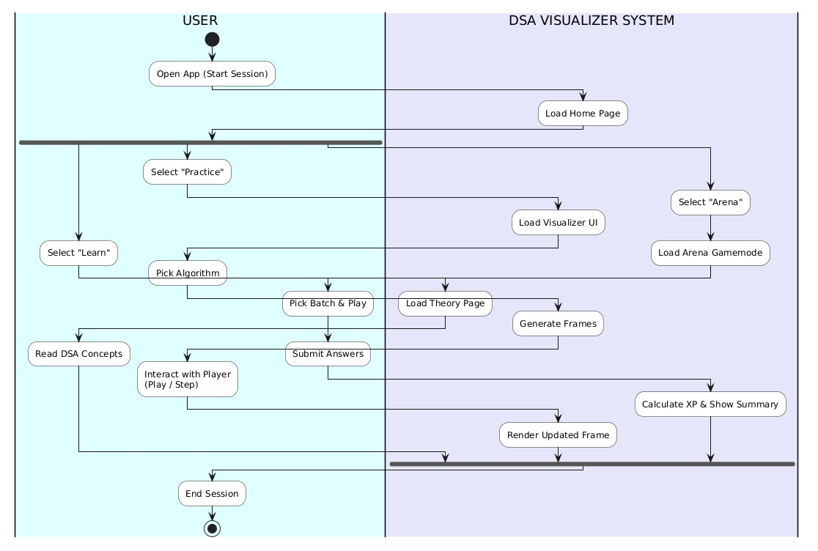
5. State Diagram
Initialization Session
Open App initiates Load Home Page
Visualizer Practice Path
Select Practice triggers Load Visualizer UI
Pick Algorithm triggers Generate Frames
Interact with Player triggers Render Updated Frame
Arena Gamification Path
Select Arena triggers Load Arena Gamement
Pick Batch & Play triggers Submit Answers
Submit Answers triggers Calculate XP & Show Summary
Theory Learning Path
Select Learn leads to Pick Algorithm
Pick Algorithm triggers Load Theory Page
Load Theory Page leads to Read DSA Concepts
Session Termination
Read DSA Concepts leads to End Session
Render Updated Frame leads to End Session
Calculate XP & Show Summary leads to End Session

Slide 8
GitHub Link
https://github.com/shreyanshsharma-1210/IREN

Slide 9
~Thank You
Any Queries

